Slide 1
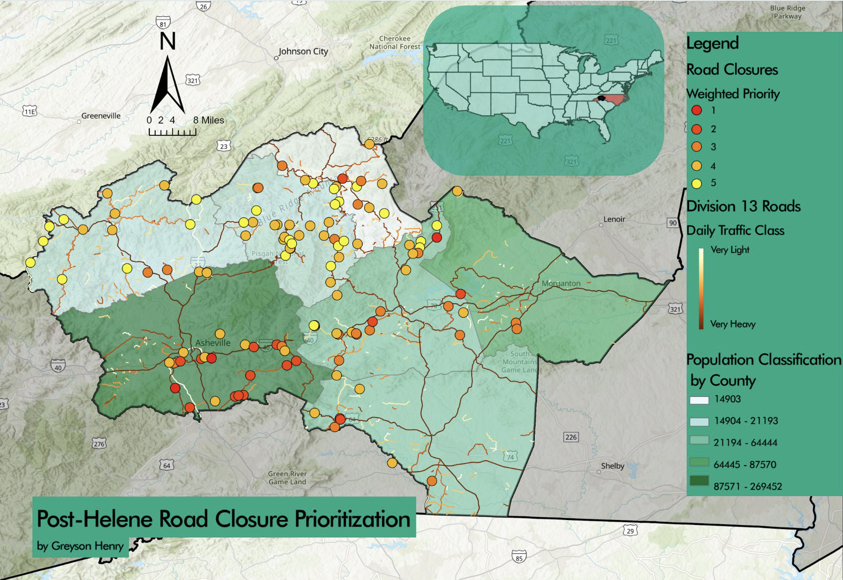
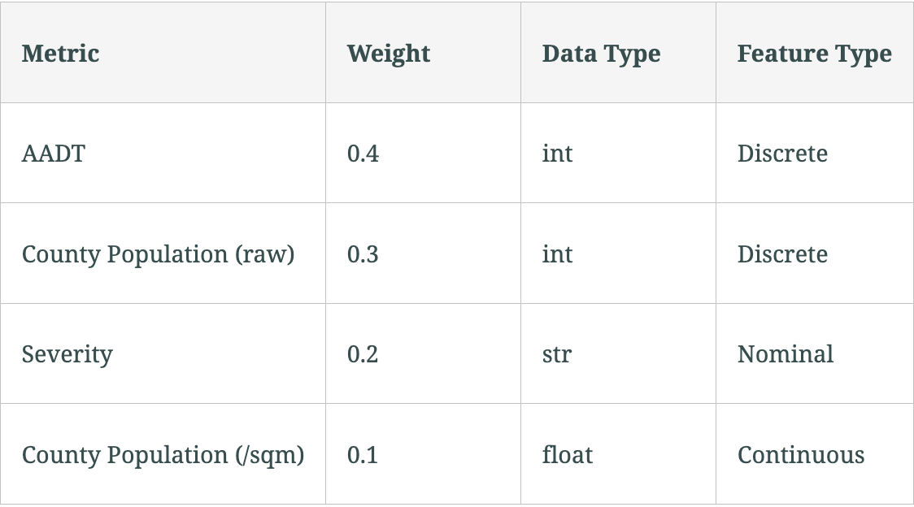
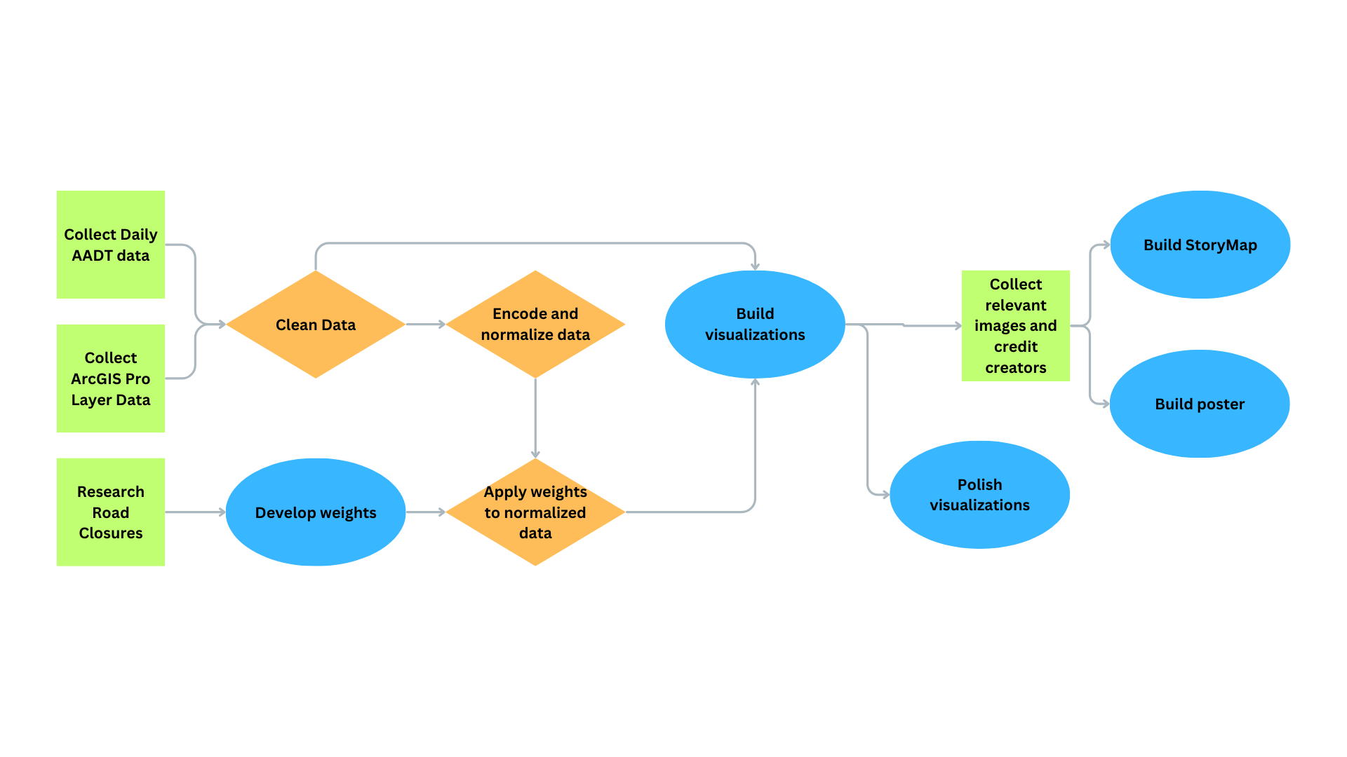
Prioritizing Road Repairs in Western North Carolina
Greyson Henry
Furman University, Department of Earth, Environmental, and Sustainability Sciences, Greenville, SC 29613
Abstract
Results
On September 24, 2024, Hurricane Helene made landfall in the Southeastern United States. A storm of unprecedented power for the area, Helene tore through Appalachia, dealing widespread and enduring damage to the region's infrastructure. While the devastation to power grids and water sanitation systems should not be understated, perhaps the most urgent type of damage was that to the area's road network. Without accessible roads, other types of disaster relief screech to a halt, unable to transport their resources and manpower to the areas that need them most.
In the wake of Helene, Western North Carolina has been faced with an uncomfortable but important question: where should its road repair efforts be focused? With limited time, budget, and on-hand resources to go around, it's necessary to prioritize the crucial incidents. This analysis aims to classify post-Helene road closures in Western North Carolina in order to highlight the most crucial/high-priority repair points. Specifically, it looks at closure incidents within NCDOT Division 13, a Department of Transportation-designated region of WNC which was left particularly ravaged in the aftermath of Helene.
After weighting with reference to factors including average annual daily traffic (AADT) and detour availability, the closures were visualized. Given the distribution of the Priority-1 points, it appears that the most crucial repairs tend to occur on the major roads to the south-southeast.
Background and Objectives
As a resident of Asheville, North Carolina, I was personally and profoundly affected by Hurricane Helene and the destruction it caused. The numerous road closures posed a real challenge to my family, and I found myself curious as to how the local and federal governments would approach such a monumental relief effort. This led to the question of: how are road repairs prioritized? Unsatisfied with the answers I found online, I did some research and, as a result, propose a repair priority order for post-hurricane repairs in Western NC.
Using ArcGIS Pro in combination with data scraped from online resources, I visualized the closures as of October 10, 2024. Then, relying on a weighting system derived from a study by Maitra, et. al., those points were assigned a priority rating from 1 to 5 depending on their urgency. Finally, the proposed repair order was contrasted with the actual repair strategy pursued by the counties within Division 13.
The objectives of this analysis are as follows:
Present a priority model for road repairs in NCDOT Division 13
Understand what patterns emerge among high- and low-priority repairs
Create an intuitive visualization of road obstructions and their priorities
Achieve a deeper understanding of what contributes to the urgency of a road closure repair
Contrast the proposed repair order to the actual repair order
Weighting
References/Data Sources
Methodology
AADT stands for Average Annual Daily Traffic, representing how much traffic the closed road has on any day of a given year.
County Population (raw) represents the raw population of the county containing the road. It's meant to serve as a proxy for how many local people rely on the road.
Severity represents the provided description of the road closure. Severity was classified and organized based on keywords.
County Population (/sqm) represents the population density of the county containing the road. Like the raw population, it serves as a proxy for how many locals use the road.
Each metric was encoded from 0 to 3 and then weighed. Based on this weighting process, each closure was given a value (from 1.5 and 3.5) and then classified into five weight classes. A weight class of 1 means the road closure is of the highest priority, while a 5 means it's of the lowest priority, and a 2-4 are higher- or lower-priority accordingly.
Maitra, Bhargab, Moen Azmi, and S. N. Ibrahim. 2002. “Prioritization of Road Projects — A Disutility Based Approach.” Transport 17 (2): 52–56. doi:10.1080/16483480.2002.10414011.
Road closure data from DriveNC
AADT Data from NCDOT
For the in-depth data source breakdown: https://docs.google.com/spreadsheets/d/1YSUDYTKq5xJYp48E57mTO3FNxc2H7xtJp6GW-qNsAzU/edit?gid=0#gid=0
Conclusions
The highest-priority road repairs tend to fall along high-traffic roads like interstates and highways.
Priority 1 and 2 roads are concentrated in the more populous regions of southern Division 13.
A theoretically effective repair strategy would focus on these roads first
The applied road repairs, at least in this circumstance, align very little with the disutility-based priorities.
The priority order produced by this analysis lacks important contribution from the affected community. It’s likely to have some erroneously high or low priorities compared to what is called for in practice.
Acknowledgements
Thanks to Dr. Suresh for his advice and guidance. Also, thanks to the TAs for being so helpful and friendly.
This project was completed as part of the required term project for Introduction to GIS (EES 201) class at Furman University

